Slide 1
(Short) Introduction to Forest Protection
Jakub Horák

Slide 2
Introduction to Forest Protection
Abiotics
Biotics
Mostly highly interconnected, e.g.:
wind and bark beetle outbreak
browsing and fungi pathogens
…

Slide 3
Introduction to Forest Protection
Abiotic factors:
Wind
Snow
Frost
Fire
Flood
…

Slide 4
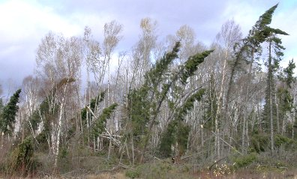
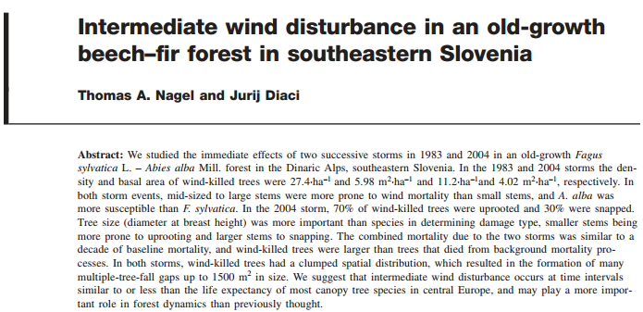
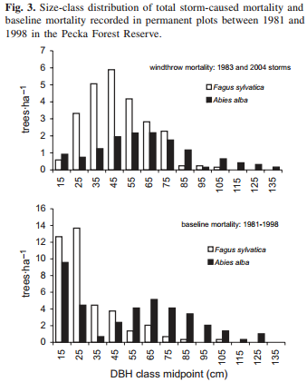
Introduction to Forest Protection
Abiotic factors:
Wind: different kinds and effects, e.g.
www.mnr.gov.on.ca

Slide 5
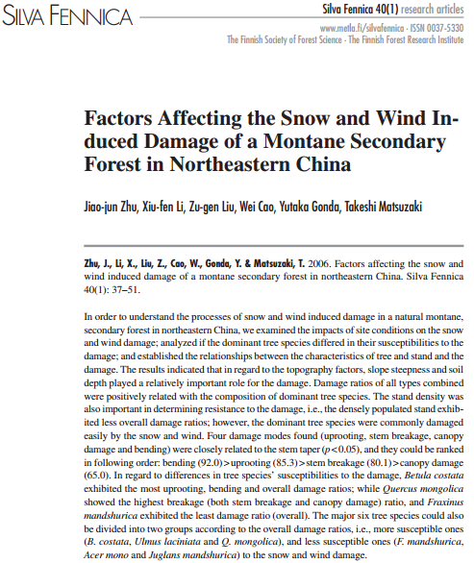
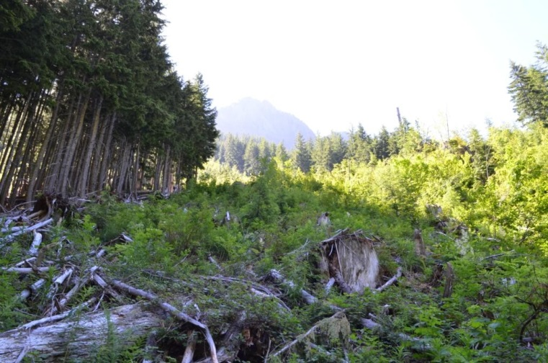
Introduction to Forest Protection
Abiotic factors:
Snow: different
kinds and effects
e.g. avalanche,
early-late snowing…
awildernessjournal.blogspot.com

Slide 6
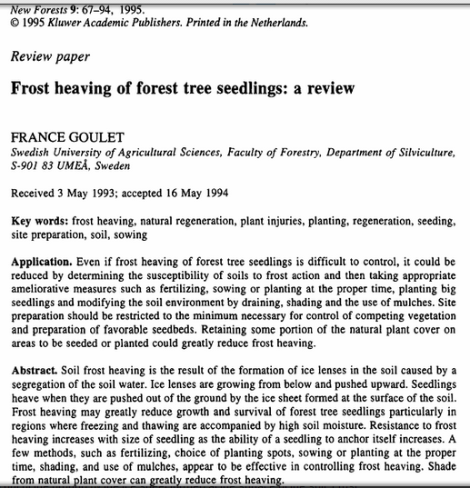
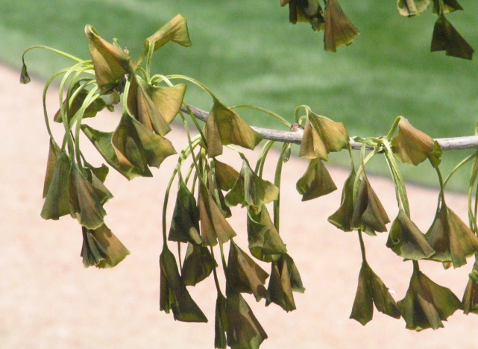
Introduction to Forest Protection
Abiotic factors:
Frost: esp. to
the seedlings or
icy to old trees
www.blueeyedcurse.com

Slide 7
Introduction to Forest Protection
Abiotic factors:
Flood

Slide 8
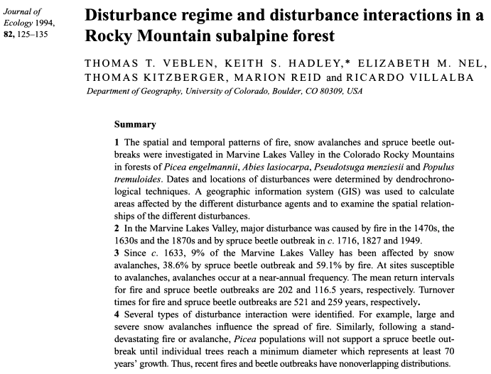
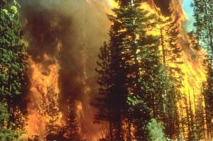
Introduction to Forest Protection
Abiotic factors:
Fire:
Immediate
effect on
human
settelments
en.wikipedia.org

Slide 9
Introduction to Forest Protection
Biotic factors:
Insect
Game stocks
Weeds
Fungi
…

Slide 10
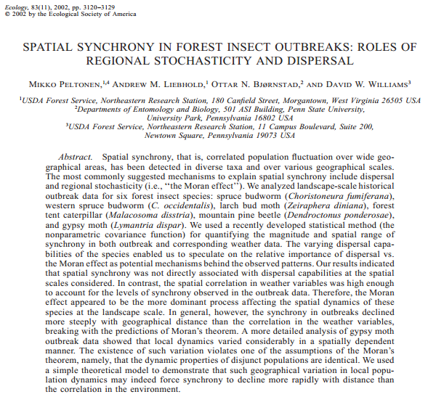
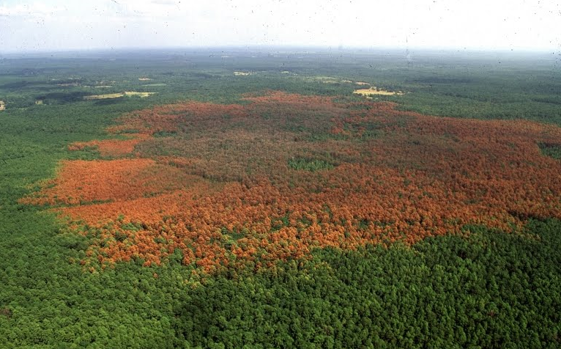
Introduction to Forest Protection
Biotic factors:
Insect: esp.
bark beetles and
moths
www.organicsoul.com

Slide 11
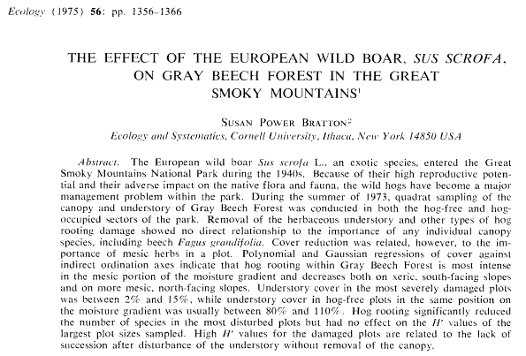
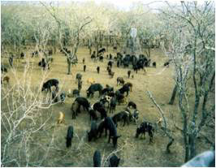
Introduction to Forest Protection
Biotic factors:
Game stocks
www.aphis.usda.gov

Slide 12
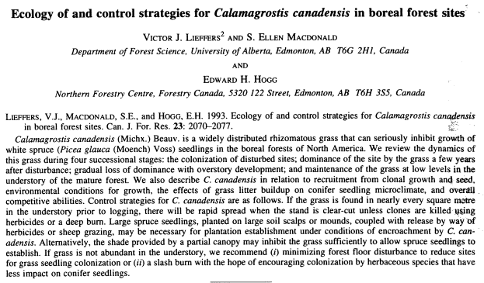
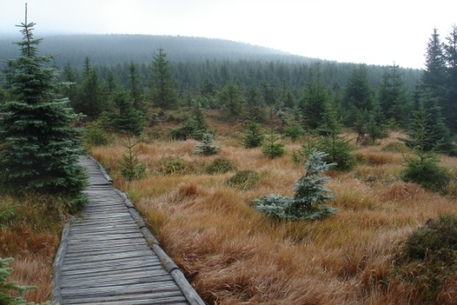
Introduction to Forest Protection
Biotic factors:
Weeds:
incl.
forest
nurseries
is.muni.cz

Slide 13
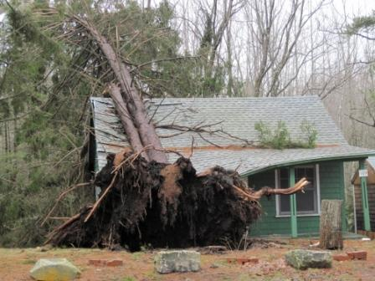
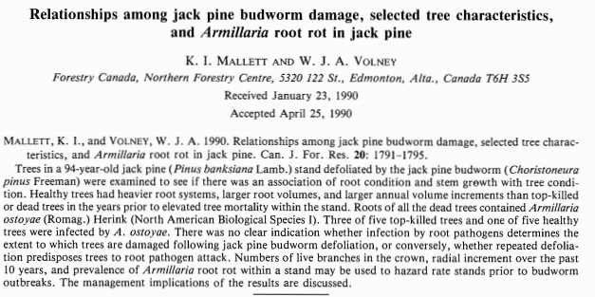
Introduction to Forest Protection
Biotic factors:
Fungi:
Wood,
leaves
and
needles
blogs.scientificamerican.com

Slide 14
Thank you for your attention

